Slide 1
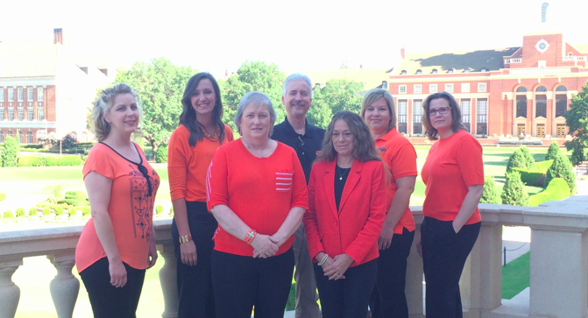
CEAT Fall Faculty Meeting
Associate Dean of Research and Sponsored Programs
Chuck Bunting

Slide 2
Expenditures (Department): FY14

Slide 3
Expenditures (Centers): FY14

Slide 4
Research Expenditures: FY14

Slide 5
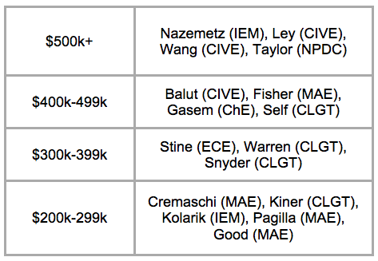
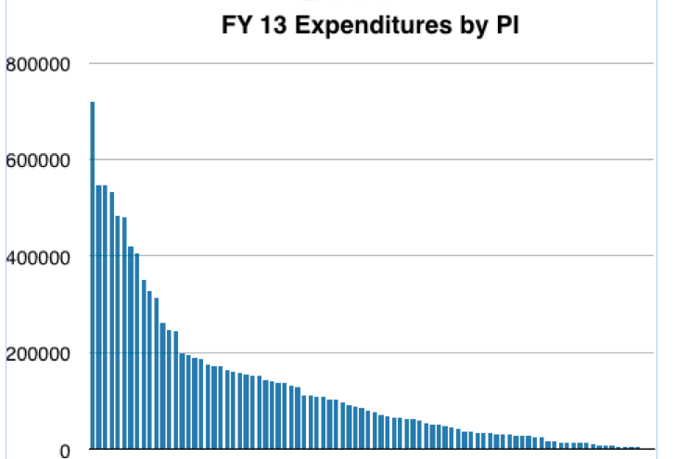
Research Expenditures: FY13
The heavy lifters…

Slide 6
Expenditures – by PI
17 PIs above $200k

Slide 7
Expenditures – the heavy lifters!
$500k + | Taylor, R. (NPDC), Nazemetz (IEM), Ley (CIVE), Wang, K.C.P. (CIVE), Arena (MAE)
$400k - $499k | Fisher, D.E. (MAE)
$300k - $399k | Snyder, G. (CLGT), Warren, S. (CLGT)
$200k - $299k | Kolarik, W.J. (IEM), Jacob, J.D. (MAE), Self, J.T. (CLGT), Stine, J.E. (ECE), Bulut, R. (CIVE), Fahlenkamp H (ChE), Heragu, S (IEM), Vashaee, D. (ECE), Good, J.K. (MAE)

Slide 8
Top 10 Proposals – FY2014
Sponsor | Amt Req | Lead PIs | Dept | Other PIs
National Aeronautics Space Administration (NASA) | $6,338,894.00 | Chowdhary | MAE | Arena (MAE), Jacob (MAE)
DOE EPSCoR | $4,971,498.00 | Singh, Raj | MSE | Burunda (CAS), Govindaraju (MSE), Lucca (MAE), Mintmire (CAS), Sarin (MSE), Vaidyanathan (MSE)
National Science Foundation (NSF) | $3,168,498.00 | Ley | CIVE | Allahkarami (CIVE), Apblett (CAS), Clark (CHE), Faraji (CIVE), Hanan (MAE), Hareland (CHE), Hartell (CIVE), Kim (CIVE
University of Arkansas | $2,018,878.00 | Vashaee | ECE | Krasinski (ECEN), Tayebi (MSE)
National Science Foundation (NSF) | $2,000,000.00 | Singh, Raj | MSE | Govindaraju (MSE), Lucca (MAE)
University of Tulsa- DOE EPSCoR | $1,725,199.00 | Aichele, C. | CHE | Clark (CHE), Henley (CAS), Maness (DASNR), Rhinehart (CHE)
National Aeronautics Space Administration (NASA) | $1,379,487.00 | Jacob, J. D. | MAE | N/A
National Institutes of Health (NIH) | $1,240,505.00 | Hatami-Marbini, H. | MAE | N/A
National Science Foundation (NSF) | $985,740.00 | Sheng, W. | ECE | Cheng (ECEN), Ma (FPST)
U.S. Department of Education (DOEd) | $974,229.00 | Cecil, J. | IEM | Mwavita (COE)

Slide 9
Top Five New Awards – FY2014
Ranking | Sponsor | Project Title | All Project PI's | $
1 | National Institutes of Health | Oklahoma Center for Respiratory and Infectious Diseases | CVHS: Liu, L.; CHE: Fahlenkamp, H.; A&S: Picking, W. | $2,476,566
2 | Federal Aviation Administration | Surface Characteristics with 3D Data and Improved Airport PCI Survey Solutions | CIVE: Wang, | $1,014,907
3 | Defense Threat Reduction Agency | Nanocarrier-mediated Targeting of Bioscavengers to the Red Blood Cell for Prolonged Circulation and Projection | CVHS: Pope, C.; CHE: Ramsey, J.D.; DASNR: Hartson, S. | $963,434
4 | Department of Energy | Surface and Airborne Monitoring Technology for Detecting Geologic Leakage in a CO2-Enhanced Oil Recovery Pilot, Anadarko Basin, Texas | CHE: Clark, P.E.; CIVE: Ley, M.T.; MAE: Jacob, J.D., Chowdhary, G.; CAS: Pashin, J., Materer, N. | $698,901
5 | Oklahoma Alliance for Manufacturing Excellence, Inc. for NIST | Enhancing the Oklahoma Alliance for Manufacturing Excellence with Applications Engineers in Rural Areas - CEAT Primary | MAE: Fisher, D.E.; DASNR: Thomas, D. | $668,417

Slide 10
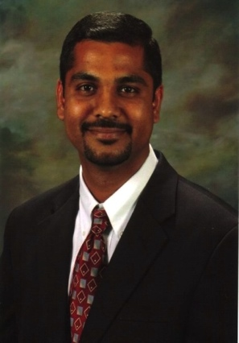
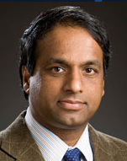
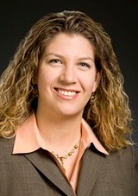
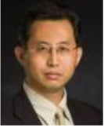
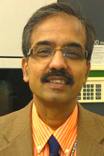
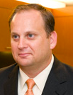
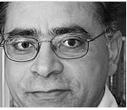
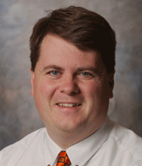
CEAT Research Council
Met regularly
Initiative development

Slide 11
CEAT Research Council
Equipment Matching:
$25k (flow cytometer)
$14k (freeze-thaw chamber)
Travel support:
Spring 2014 NSF Grants Conference
Student travel (to conferences)
Coming soon:
Mentoring
Student support – final semester augmentation
Seminar series
More travel – we need exposure!

Slide 12
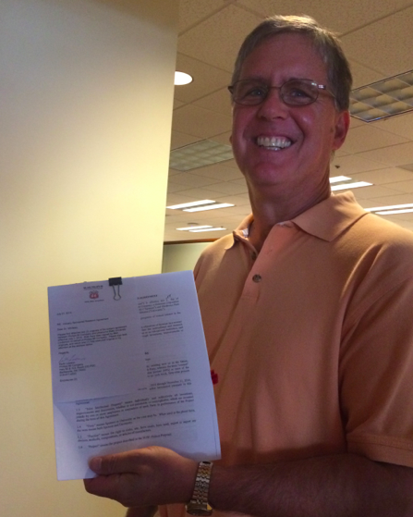
ADR happenings
Sponsored Research Agreement (SRA)
CEAT Research involvement --- Phillips 66
Participated in discussions with the University Multispectral Lab (UML) and the reorganization under the Cherokee Nation.

Slide 13
ADR happenings
Emphasis of CEAT on improving the quality of proposals submitted
Department head connections – highly valued!!
Collegiality among ADRs

Slide 14
Goals for FY 2015:
Continue to identify and leverage college strengths for optimal proposal opportunities for industry and federal support
Develop specific collaboration plans for center proposal efforts (3-5 year lifetimes) in targeted areas.
Mentor young faculty in proposal development including writing/review workshops and encourage active participation in panel reviews.
Notes:
In particular I have the responsibility to assist in the coordination of complex proposal activities. Sometimes this may mean waving faculty off their plans to submit a premature and inadequate proposal when better planning will provide a much better use of their time. Most certainly it will mean more coordination with departmental leadership

